Slide 1
GOOD AFTERNOON
PRESENTATION
FROM
NITIN(SQAM)
B/C-485
9

Slide 2
Definition of ARRAY
The array, which stores a fixed-size sequential collection of elements of the same type. An array is used to store a collection of data, but it is often more useful to think of an array as a collection of variables of the same type.
Instead of declaring individual variables, such as number0, number1, ..., and number99, you declare one array variable such as numbers and use numbers[0], numbers[1], and ..., numbers[99] to represent individual variables.

Slide 3
Largest Number with the help of array
public static void main (String[] args) throws java.lang.Exception
{
int [ ] larg= {10,20,30,10,11,14};
int size = larg.length;
for(int i = 0; i < size; i++)
{
System.out.println(larg[i] +" ");
}
int max = 0;
for (int i=0; i<size;i++ )
{ if(larg[i]> max)
max = larg[i]; }
System.out.println("Maximum value:" +max);
}
}

Slide 4
OUTPUT
10
20
30
10
11
14
Maximum value:30

Slide 5
LINEAR SERIES
{ int [ ] lin = {10,20,30,10,11,14};
int size = lin.length;
Int i ;
for ( i = 0; i < size; i++)
{ System.out.println(lin[i]); }
int search= 30;
for (i = 0; i < size; i++)
{ if (lin[i] == search)
{ System.out.println(search + " is present at location " + (i ) + ".");
break; }
}
if (i == size)
System.out.println(search + " is not present in array.");
}
}

Slide 6
OUTPUT
For search = 30
10
20
30
10
11
14
30 is present at location 2.
For search = 400
10
20
30
10
11
14
400 is not present in array.

Slide 7
Frequency of Number Element
{ int []freq = {1,0,9,0,7,2,0};
int l = freq.length;
int element=0 ;
int count=0 ;
for(int i=0; i<l; i++)
{ int tempelement = freq[i];
int tempcount=0 ;
for (int j=0;j<l;j++)
{ if(freq[j]==tempelement)
tempcount++;
if(tempcount>count)
{element=tempelement; count = tempcount;}
} }
System.out.println(" Frequent of element is"+" "+element+" "+count); }}

Slide 8
OUTPUT
Frequent of element is 0 3

Slide 9

PUZZLE - 1
At a party, everyone shook hands with everybody else. There were 66 handshakes. How many people were at the party?

Slide 10
Answer
12.
if there are n+1 people.
no. of handshakes=n
n*(n+1)/2=66

Slide 11
PUZZLE - 2
There is a basket full of hats. 3 of them are white and 2 of them are black. There are 3 men Tom, Tim, and Jim. They each take a hat out of the basket and put it on their heads without seeing the hat they selected or the hats the other men selected. The men arrange themselves so Tom can see Tim and Jim’s hats, Tim can see Jim’s hat, and Jim can’t see anyone’s hat.
Tom is asked what color his hat is and he says he doesn’t know.
Tim is asked the same question, and he also doesn’t know.
Finally, Jim is asked the question, and he does know.
What color is his hat?

Slide 12
ANSWER
The hat is white. If Tom doesn’t know his hat color then the other two men’s hats cannot be both black otherwise he would know his is white. When Tim doesn’t know his hat color either, that means Jim’s hat could not be black otherwise Tim would have to know his hat was white to fulfill the information discovered through Tom’s answer.

Slide 13
PUZZLE
Two ducks in front of a duck, two ducks behind a duck, one duck in the middle
How many ducks are there?

Slide 14
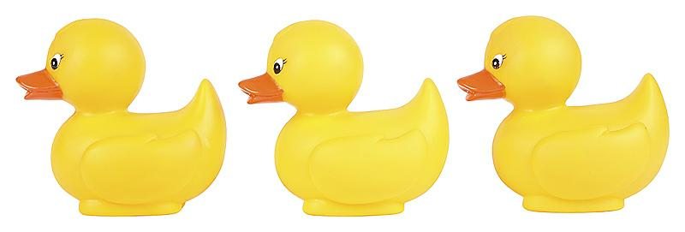
ANSWER
Three Ducks
They’re all in a row, so ducks 1 and 2 are in front of duck 3, ducks 2 and 3 are behind duck 1 and duck 2 is in the middle.

Slide 15
SUMMARY
Linear Series
Greatest Number
Frequency of a Number
Puzzels

